Slide 1

rba_Msc concept & design
rba_Msc
Micro Second Channel
Cross Divisional Group - Software, Methods and Tools
Internal | CDG-SMT/ESA1 | 2013-06-11 | © Robert Bosch GmbH 2013. All rights reserved, also regarding any disposal, exploitation, reproduction, editing, distribution, as well as in the event of applications for industrial property rights.

Slide 2
Overview (1)
rba_Msc concept & design: Overview
Communication bus for ECU internal communication with uC external ASICs like
CJ950: power stage
CJ960: power stage
CJ721: low budget device integrating power supply, power stages and external watch dog
...
Supports PWM signals on data frame controlled power stages due to fast downstream channel (20MBaud)
Replaces parallel input connections of power stages and therefore reduces PCP layout foot print
Asynchronous upstream for diagnosis and register access
Cross Divisional Group - Software, Methods and Tools
Internal | CDG-SMT/ESA1 | 2013-06-11 | © Robert Bosch GmbH 2013. All rights reserved, also regarding any disposal, exploitation, reproduction, editing, distribution, as well as in the event of applications for industrial property rights.

Slide 3
Overview (2)
rba_Msc concept & design: Overview
The rba_Msc driver/handler utilises the uCs HW to provide MSC connections to MSC slaves. This includes
initialisation of HW units
activation of downstream channel
continuous transmission of data frames
handling of command frames
handling of upstream frames
Cross Divisional Group - Software, Methods and Tools
Internal | CDG-SMT/ESA1 | 2013-06-11 | © Robert Bosch GmbH 2013. All rights reserved, also regarding any disposal, exploitation, reproduction, editing, distribution, as well as in the event of applications for industrial property rights.

Slide 4
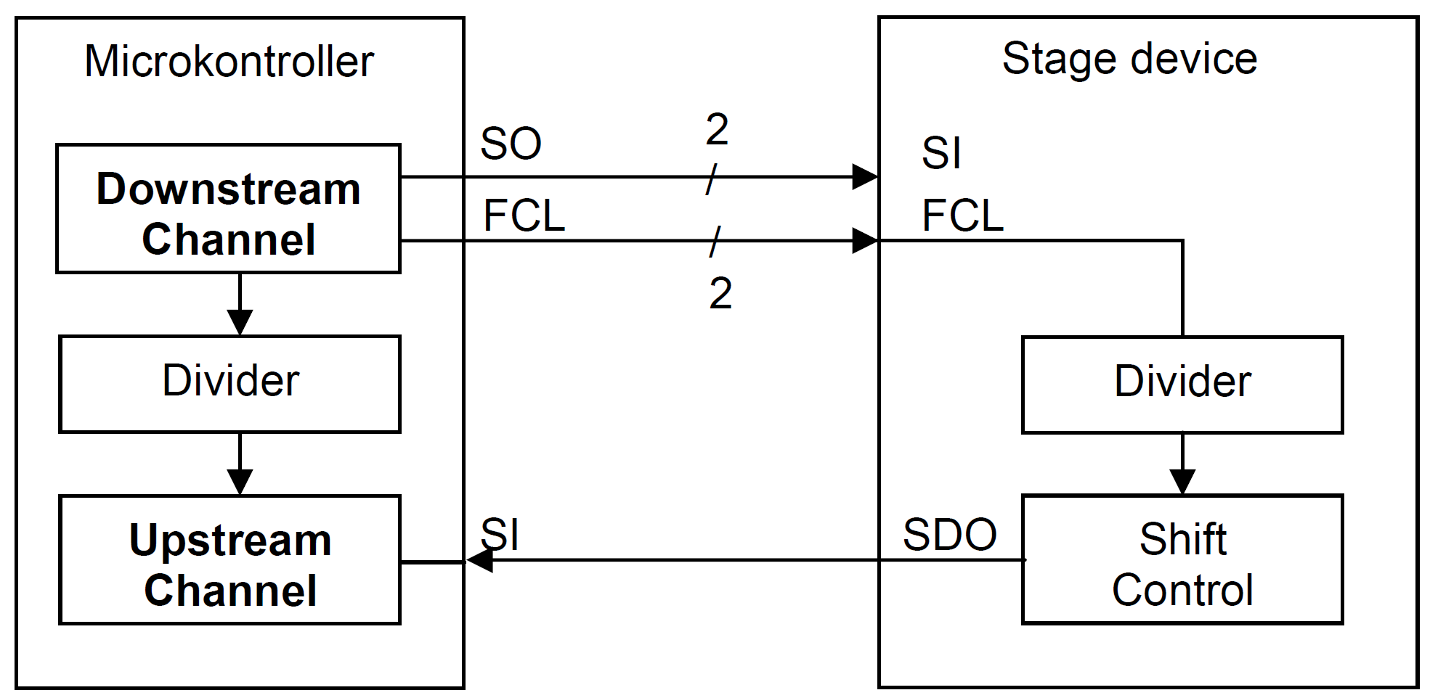
HW usage and bus structure
rba_Msc concept & design: Overview
differential signals
EN
IFX: Downstream and upstream handled by MSC modules (MSC0 ... MSC2)
JDP: Downstream handled by DSPI, upstream handled by LINFlexD (MSC0 → DSPI_4 + LINFlexD_14, MSC1 → DSPI_5 + LINFlexD_15, MSC2 → DSPI_6 + LINFlexD_16)
Cross Divisional Group - Software, Methods and Tools
Internal | CDG-SMT/ESA1 | 2013-06-11 | © Robert Bosch GmbH 2013. All rights reserved, also regarding any disposal, exploitation, reproduction, editing, distribution, as well as in the event of applications for industrial property rights.

Slide 5
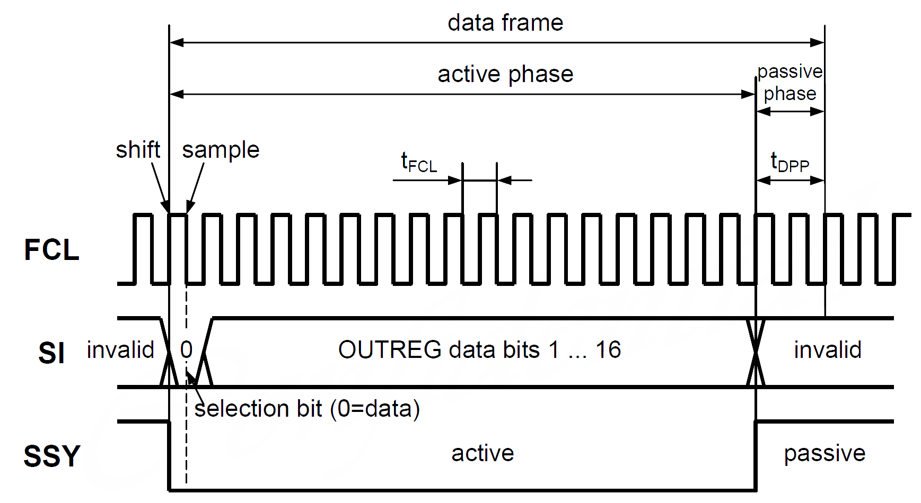
Downstream data frame (CJ950)
rba_Msc concept & design: Overview
Cross Divisional Group - Software, Methods and Tools
Internal | CDG-SMT/ESA1 | 2013-06-11 | © Robert Bosch GmbH 2013. All rights reserved, also regarding any disposal, exploitation, reproduction, editing, distribution, as well as in the event of applications for industrial property rights.

Slide 6
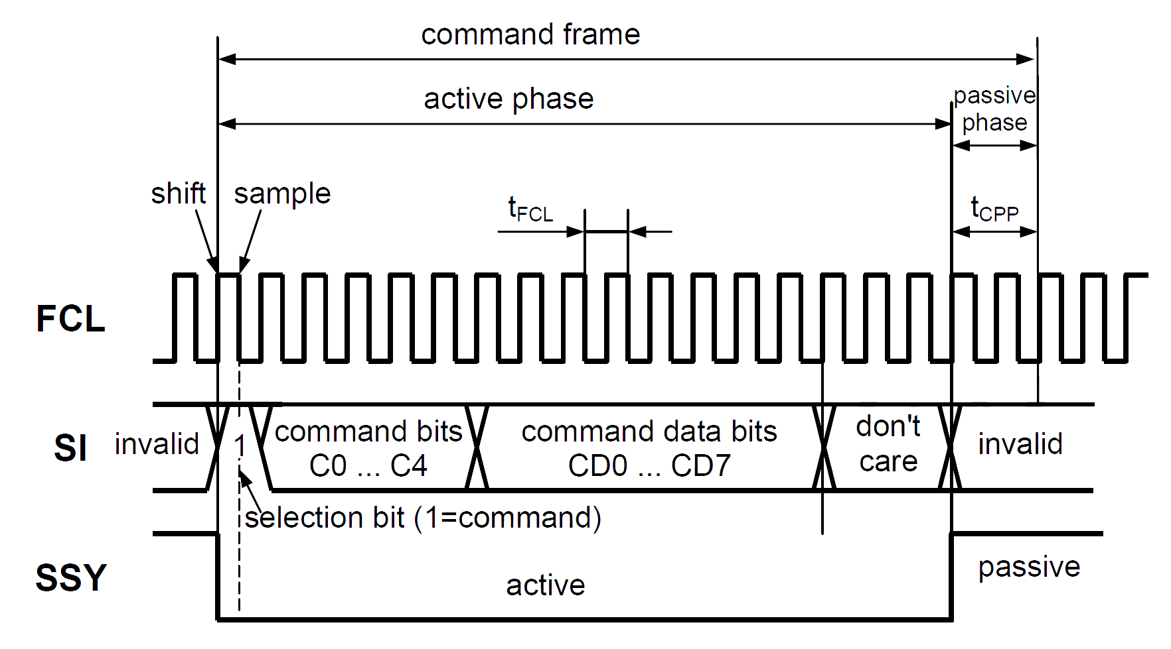
Downstream command frame (CJ950)
rba_Msc concept & design: Overview
Cross Divisional Group - Software, Methods and Tools
Internal | CDG-SMT/ESA1 | 2013-06-11 | © Robert Bosch GmbH 2013. All rights reserved, also regarding any disposal, exploitation, reproduction, editing, distribution, as well as in the event of applications for industrial property rights.

Slide 7
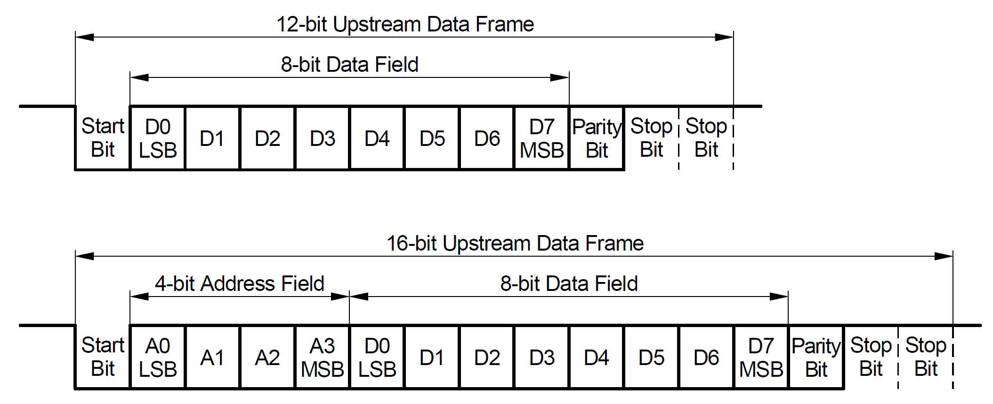
Upstream frame
rba_Msc concept & design: Overview
CJ950
CJ721
Cross Divisional Group - Software, Methods and Tools
Internal | CDG-SMT/ESA1 | 2013-06-11 | © Robert Bosch GmbH 2013. All rights reserved, also regarding any disposal, exploitation, reproduction, editing, distribution, as well as in the event of applications for industrial property rights.

Slide 8
Requirements (1)
rba_Msc concept & design: Requirements
The downstream channel shall have the following properties
continuous clock signal
passive phase of 2 clock cycles
20 MHz downstream clock
support dual receiver mode for up to 2 devices per MSC bus
support up to 32 bits per device for uC device 2 in dual receiver mode
Cross Divisional Group - Software, Methods and Tools
Internal | CDG-SMT/ESA1 | 2013-06-11 | © Robert Bosch GmbH 2013. All rights reserved, also regarding any disposal, exploitation, reproduction, editing, distribution, as well as in the event of applications for industrial property rights.

Slide 9
Requirements (2)
rba_Msc concept & design: Requirements
For handling of the command frames the MSC driver/handler shall provide interfaces to
transmit a command
while interrupts are disabled the command shall be transmitted immediately in a synchronous manner
while interrupts are available the command shall be queued and transmitted in an asynchronous manner
get the result/status of the command
get the current command value
set the command value
get the current number of upstream frames
set the number of upstream frames
the number of upstream frames is limited to the configured maximum number of upstream frames
get the pointer to the upstream buffer
Cross Divisional Group - Software, Methods and Tools
Internal | CDG-SMT/ESA1 | 2013-06-11 | © Robert Bosch GmbH 2013. All rights reserved, also regarding any disposal, exploitation, reproduction, editing, distribution, as well as in the event of applications for industrial property rights.

Slide 10
Requirements (3)
rba_Msc concept & design: Requirements
For handling of signals the MSC driver/handler shall provide interfaces to
get the current internal signal value
set the internal signal value
get the current state of the downstream date multiplexer
only required for signals with external source
set the state of the downstream data multiplexer
only required for signals with external source
Cross Divisional Group - Software, Methods and Tools
Internal | CDG-SMT/ESA1 | 2013-06-11 | © Robert Bosch GmbH 2013. All rights reserved, also regarding any disposal, exploitation, reproduction, editing, distribution, as well as in the event of applications for industrial property rights.

Slide 11
Requirements (4)
rba_Msc concept & design: Requirements
For control of the MSC driver/handler it shall provide interfaces/processes to
initialize the driver by means of EcuM
switch the driver from synchronous polling mode to asynchronous interrupt mode
this transition is only required once during start up
shut down queue handling of the driver and switch from asynchronous interrupt mode to synchronous polling mode
this transition is only required once during shut down, ECU will be switched off or re-started afterwards
this transition shall be done when interrupts are already disabled
this is implemented as rba_Msc_SwtToSync()
the original implementation rba_Msc_ShDwn() needs interrupts to be enabled
Cross Divisional Group - Software, Methods and Tools
Internal | CDG-SMT/ESA1 | 2013-06-11 | © Robert Bosch GmbH 2013. All rights reserved, also regarding any disposal, exploitation, reproduction, editing, distribution, as well as in the event of applications for industrial property rights.

Slide 12
Requirements (5)
rba_Msc concept & design: Requirements
To detect development and integration errors the MSC driver/handler shall
check in each API if the driver is in the desired state and report errors to DET
check in each API if the parameters are valid and report errors to DET
reporting to DET shall be enabled/disabled by configuration means
Cross Divisional Group - Software, Methods and Tools
Internal | CDG-SMT/ESA1 | 2013-06-11 | © Robert Bosch GmbH 2013. All rights reserved, also regarding any disposal, exploitation, reproduction, editing, distribution, as well as in the event of applications for industrial property rights.

Slide 13
Requirements (6)
rba_Msc concept & design: Requirements
The configuration of the MSC driver/handler shall provide means to
optionally configure the minimum upstream baud rate for a MSC device
the configuration script shall check if the actual upstream baud rate meets the configured minimum upstream baud rate
optionally configure the downstream baud rate to meet HW restrictions
Cross Divisional Group - Software, Methods and Tools
Internal | CDG-SMT/ESA1 | 2013-06-11 | © Robert Bosch GmbH 2013. All rights reserved, also regarding any disposal, exploitation, reproduction, editing, distribution, as well as in the event of applications for industrial property rights.

Slide 14
Limitations
rba_Msc concept & design: Limitations
The following limitations apply
Data frame length 4 to 32 bit
Lower boundary 4 is limited by JDP
Command frame length 0 and 4 to 16 bit
Not supported 1, 2, 3 and upper boundary is limited by JDP
Upstream support requires valid command frame length != 0
Without commands there is no upstream communication
Upstream divisor 0, 2, 4, 8, 16, 32, 64, 128
0 = no upstream communication
other settings are limited by IFX
Supported upstream frame types:
0 = no upstream communication
12, 13 (without address field, 2 or 3 stop bits)
16, 17 (with address field, 2 or 3 stop bits)
Cross Divisional Group - Software, Methods and Tools
Internal | CDG-SMT/ESA1 | 2013-06-11 | © Robert Bosch GmbH 2013. All rights reserved, also regarding any disposal, exploitation, reproduction, editing, distribution, as well as in the event of applications for industrial property rights.

Slide 15
Interfaces (1)
rba_Msc concept & design: Interfaces
void rba_Msc_Init(const rba_Msc_ConfigType * xPbCfg_pcen)
Initialize the driver using the given post build configuration set
void rba_Msc_PostPort_Init(void)
Complete initialization and start downstream data frames
void rba_Msc_End_Init(void)
Process to be called as soon as interrupts are available in the system
Switches from synchronous polling mode to asynchronous interrupt mode
void rba_Msc_ShDwn(void)
API to be called just before entering shut down phase of the system
Clears queues and switches from asynchronous interrupt to synchronous polling mode
Interrupts must be enabled, so that the queue handler can operate using its ISRs
void rba_Msc_SwtToSync(void)
API to be called when entering shut down phase of the system
Clears queues and switches from asynchronous interrupt to synchronous polling mode
Interrupts must be disabled, there must be no active rba_Msc ISR on any core
An ongoing transmission (started using ISRs) will be completed without ISRs
Cross Divisional Group - Software, Methods and Tools
Internal | CDG-SMT/ESA1 | 2013-06-11 | © Robert Bosch GmbH 2013. All rights reserved, also regarding any disposal, exploitation, reproduction, editing, distribution, as well as in the event of applications for industrial property rights.

Slide 16
Interfaces (2)
rba_Msc concept & design: Interfaces
Std_ReturnType rba_Msc_GetCmdVal(rba_Msc_idxSig_tuo idxSig_uo, rba_Msc_xCmdVal_tuo * xCmdVal_puo)
Get the current command value of the given command, MEDC17 “Msc_GetCmd”
Std_ReturnType rba_Msc_SetCmdVal(rba_Msc_idxCmd_tuo idxCmd_uo, rba_Msc_xCmdVal_tuo xCmdVal_uo)
Set the command value of the given command, MEDC17 “Msc_SetCmd”
Std_ReturnType rba_Msc_GetNrUsFrm (rba_Msc_idxCmd_tuo idxCmd_uo, uint8_least * nrUsFrm_pqu8)
Get the current number of upstream frames of the given command
Std_ReturnType rba_Msc_SetNrUsFrm (rba_Msc_idxCmd_tuo idxCmd_uo, uint8_least nrUsFrm_qu8)
Set the number of upstream frames of the given command, MEDC17 “Msc_SetNumUsFrm”
Cross Divisional Group - Software, Methods and Tools
Internal | CDG-SMT/ESA1 | 2013-06-11 | © Robert Bosch GmbH 2013. All rights reserved, also regarding any disposal, exploitation, reproduction, editing, distribution, as well as in the event of applications for industrial property rights.

Slide 17
Interfaces (3)
rba_Msc concept & design: Interfaces
Std_ReturnType rba_Msc_Transmit(rba_Msc_idxCmd_tuo idxCmd_uo)
Transmit the given command, MEDC17 “Msc_ActvCmd”
Std_ReturnType rba_Msc_GetCmdResult (rba_Msc_idxCmd_tuo idxCmd_uo, rba_Msc_xCmdResult_ten * xCmdResult_pen)
Get the result of the given command, MEDC17 “Msc_GetCmdSt”
Return values are rba_Msc_CmdOk_e, rba_Msc_CmdPending_e, rba_Msc_CmdPending_e, rba_Msc_CmdNotUsdYet_e, rba_Msc_CmdNotCfg_e
Std_ReturnType rba_Msc_GetUsBuf(rba_Msc_idxCmd_tuo idxCmd_uo, uint8 ** xUsBuf_ppu8)
Get base address of upstream buffer for the given command, MEDC17 “Msc_GetUsBuf”
Cross Divisional Group - Software, Methods and Tools
Internal | CDG-SMT/ESA1 | 2013-06-11 | © Robert Bosch GmbH 2013. All rights reserved, also regarding any disposal, exploitation, reproduction, editing, distribution, as well as in the event of applications for industrial property rights.

Slide 18
Interfaces (4)
rba_Msc concept & design: Interfaces
Std_ReturnType rba_Msc_GetSigVal(rba_Msc_idxSig_tuo idxSig_uo, boolean * stSig_pb)
Get the current value of the given signal (GPIO), MEDC17 “Msc_GetDD”
Std_ReturnType rba_Msc_SetSigVal(rba_Msc_idxSig_tuo idxSig_uo, boolean stSig_b)
Set the value of the given signal (GPIO), MEDC17 “Msc_SetDD”
Std_ReturnType rba_Msc_GetMux(rba_Msc_idxSig_tuo idxSig_uo, boolean * stMux_pb)
Get the current MSC multiplexer setting of the given signal, MEDC17 “Msc_GetMux”
Std_ReturnType rba_Msc_SetMux(rba_Msc_idxSig_tuo idxSig_uo, boolean stMux_b)
Set the MSC multiplexer of the given signal, MEDC17 “Msc_SetMux”
Cross Divisional Group - Software, Methods and Tools
Internal | CDG-SMT/ESA1 | 2013-06-11 | © Robert Bosch GmbH 2013. All rights reserved, also regarding any disposal, exploitation, reproduction, editing, distribution, as well as in the event of applications for industrial property rights.

Slide 19
Enable/disable asynchronous mode
rba_Msc concept & design: Configuration
Provide configuration parameter rba_Msc_EnaAsyncMode
false: only synchronous mode is present
true (default): synchronous and asynchronous mode is present
Provide macro RBA_MSC_CFG_ASYNC_MODE which is set depending on configuration parameter rba_Msc_EnaAsyncMode
STD_OFF: no asynchronous mode present
STD_ON: asynchronous mode is present
If asynchronous mode is disabled
remove dependencies to rba_MemLay and rba_Dma
remove asynchronous handler related code
remove asynchronous related APIs
rba_Msc_End_Init
rba_Msc_ShDwn
rba_Msc_SwtToSync
Cross Divisional Group - Software, Methods and Tools
Internal | CDG-SMT/ESA1 | 2013-06-11 | © Robert Bosch GmbH 2013. All rights reserved, also regarding any disposal, exploitation, reproduction, editing, distribution, as well as in the event of applications for industrial property rights.

Slide 20
Initialization order
rba_Msc concept & design: Initialization
EcuM initialization
...
Initialize internal registers,
set MSC bus signals to a defined state
rba_Msc_Init()
...
Port_Init()
Connect MSC bus signals to port pins
...
Enable downstream,
start with data frame transmission
rba_Msc_PostPort_Init()
...
...
Interrupts must be enabled
rba_Dma_Init() must be called
OS initialization task
...
rba_Msc_End_Init()
Switch to interrupt mode with
queue handling
...
Cross Divisional Group - Software, Methods and Tools
Internal | CDG-SMT/ESA1 | 2013-06-11 | © Robert Bosch GmbH 2013. All rights reserved, also regarding any disposal, exploitation, reproduction, editing, distribution, as well as in the event of applications for industrial property rights.

Slide 21
Initialization states
rba_Msc concept & design: Initialization
rba_Msc_Prv_stInitialized_b = FALSE;
rba_Msc_Prv_stDsEnabled_b = FALSE;
rba_Msc_Prv_stInterruptMode_b = FALSE;
EcuM initialization
...
rba_Msc_Init()
rba_Msc_Prv_stInitialized_b = TRUE;
Modification of MSC signals is
allowed after rba_Msc_Init()
e.g. use rba_Msc_SetSigVal() or rba_Msc_SetMux()
...
rba_Msc_PostPort_Init()
rba_Msc_Prv_stDsEnabled_b = TRUE;
...
...
Transmission of MSC commands is allowed after rba_Msc_PostPort_Init()
e.g. use rba_Msc_Transmit ()
OS initialization task
...
rba_Msc_End_Init()
rba_Msc_Prv_stInterruptMode_b = TRUE;
...
Cross Divisional Group - Software, Methods and Tools
Internal | CDG-SMT/ESA1 | 2013-06-11 | © Robert Bosch GmbH 2013. All rights reserved, also regarding any disposal, exploitation, reproduction, editing, distribution, as well as in the event of applications for industrial property rights.

Slide 22
Initialization state checks by APIs
rba_Msc concept & design: Initialization
All APIs check the necessary initialization state
rba_Msc_Prv_stInitialized_b = TRUE is checked by
rba_Msc_GetCmdResult()
rba_Msc_GetCmdVal(), rba_Msc_SetCmdVal()
rba_Msc_GetMux(), rba_Msc_SetMux()
rba_Msc_GetSigVal(), rba_Msc_SetSigVal()
rba_Msc_GetNrUsFrm(), rba_Msc_SetNrUsFrm()
rba_Msc_GetUsBuf()
rba_Msc_Prv_stDsEnabled_b = TRUE is checked by
rba_Msc_Transmit()
rba_Msc_ShDwn()
rba_Msc_SwtToSync()
In case the initialization state is not as expected issue a DET
Cross Divisional Group - Software, Methods and Tools
Internal | CDG-SMT/ESA1 | 2013-06-11 | © Robert Bosch GmbH 2013. All rights reserved, also regarding any disposal, exploitation, reproduction, editing, distribution, as well as in the event of applications for industrial property rights.

Slide 23
Requirements for MDG1
rba_Msc concept & design: Asynchronous handler
Asynchronous command transmissions must ensure the following latency requirements:
maximum 1ms for high prio queue (prio index > 0)
maximum 10ms for low prio queue (prio index = 0)
Latency is defined to be the time from requesting a command transmission to completion of the command (including upstream if used by the command)
Cross Divisional Group - Software, Methods and Tools
Internal | CDG-SMT/ESA1 | 2013-06-11 | © Robert Bosch GmbH 2013. All rights reserved, also regarding any disposal, exploitation, reproduction, editing, distribution, as well as in the event of applications for industrial property rights.

Slide 24
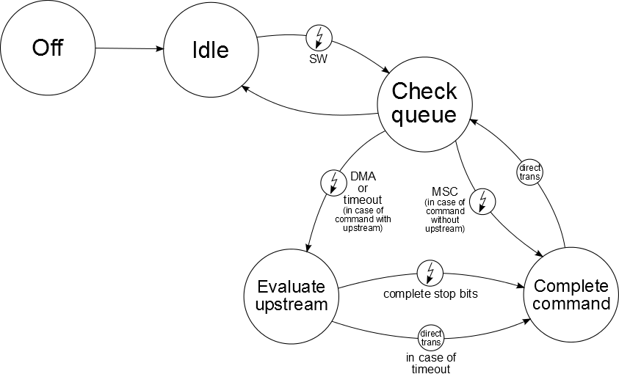
States of asynchronous handler
rba_Msc concept & design: Asynchronous handler
Cross Divisional Group - Software, Methods and Tools
Internal | CDG-SMT/ESA1 | 2013-06-11 | © Robert Bosch GmbH 2013. All rights reserved, also regarding any disposal, exploitation, reproduction, editing, distribution, as well as in the event of applications for industrial property rights.

Slide 25
Handler operation (1)
rba_Msc concept & design: Asynchronous handler
After initialization the MSC handler/driver is in synchronous mode (because interrupts are disabled), the handler is in state off
Command requests (call of rba_Msc_Transmit()) are transmitted immediately in a synchronous manner (blocking call)
As soon as interrupts are available rba_Msc_End_Init() may be called, which switches the MSC handler/driver to asynchronous mode, the handler switches to state idle
In state idle the handler is not running, queues are empty
Command requests (call of rba_Msc_Transmit()) are queued depending on HW unit and priority
While the handler is in state idle the 1st command request triggers the handler using a SW interrupt
Cross Divisional Group - Software, Methods and Tools
Internal | CDG-SMT/ESA1 | 2013-06-11 | © Robert Bosch GmbH 2013. All rights reserved, also regarding any disposal, exploitation, reproduction, editing, distribution, as well as in the event of applications for industrial property rights.

Slide 26
Handler operation (2)
rba_Msc concept & design: Asynchronous handler
The SW interrupt is triggered under the same global lock as the command request is added to the queue
This ensures little latency for the start of the handler
The start of the handler can not be delayed by higher priority tasks
The handler starts on interrupt level and checks the queues
A new entry is processed according to the state machine
As long as queue entries are present the handler will operate on interrupt level
Interrupts are triggered by HW depending on the current state
After processing the last queue entry the queue is checked again
When no entries are found, the handler switches to state idle
There are no more HW interrupts triggering the handler
The next command request will again trigger the handler using the SW interrupt
Cross Divisional Group - Software, Methods and Tools
Internal | CDG-SMT/ESA1 | 2013-06-11 | © Robert Bosch GmbH 2013. All rights reserved, also regarding any disposal, exploitation, reproduction, editing, distribution, as well as in the event of applications for industrial property rights.

Slide 27
SW interrupt notes
rba_Msc concept & design: Asynchronous handler
IFX: SW interrupt is realized by manually triggering the SRN used for HW events “command frame sent” and “timeout”
JDP: SW interrupt is realized by causing a “timeout” event
Ideally the timeout value should be set to 0 to cause an immediate interrupt, but a value of 0 would violate the JDP specification: Taken from the LINFlexD spec: "PTO defines the preset value of timeout counter. A zero-value is forbidden, otherwise the UARTSR[TO] status bit is immediately set. Refer also to register UARTCTO.“
An immediate interrupt is the desired behavior but according to JDP the statement "zero-value is forbidden" may only be ignored in special cases. Therefore to be on the safe side for future clock changes choose 1 as a timeout, which will trigger the timeout interrupt with a delay of 1 upstream bit time (if it is not already pending).
The typical upstream bit time is 3.84 us (@16.667MHz and upstream divisor 64). This delay is considered to be uncritical and may be neglected.
Further an already pending timeout interrupt is not cleared when the handler needs to be started by SW interrupt. It is expected that the timeout interrupt is already set at this point because the timeout counter keeps running and will overflow regularly. Therefore the interrupt will be active as soon as the interrupt enable bit is set which corresponds to an immediate interrupt.
Cross Divisional Group - Software, Methods and Tools
Internal | CDG-SMT/ESA1 | 2013-06-11 | © Robert Bosch GmbH 2013. All rights reserved, also regarding any disposal, exploitation, reproduction, editing, distribution, as well as in the event of applications for industrial property rights.

Slide 28
Problems of previous design
rba_Msc concept & design: Asynchronous handler
In version COMP : rba_Msc / AR40.3.0.0; 0 and earlier
Start of handler from state idle is accomplished by calling the handler
Due to the runtime this call could not be done under lock
If the handler is called on a low prio task it is possible that a higher priority task can interrupt the call of the handler
This may delay the start of the handler by the runtime of the higher priority task → The latency requirement may not be fulfilled
Cross Divisional Group - Software, Methods and Tools
Internal | CDG-SMT/ESA1 | 2013-06-11 | © Robert Bosch GmbH 2013. All rights reserved, also regarding any disposal, exploitation, reproduction, editing, distribution, as well as in the event of applications for industrial property rights.

Slide 29
Support of reduced configuration set
rba_Msc concept & design: Reduced configuration
In case MSC is used in a reduced configuration set, some of the arrays are created with size 0. For portability reasons this should not be done. From FC-ARB : rba_Msc / 1.23.0; 0, the situation where there are no upstream frames, no commands or no signals is tested.
If there are no commands configured, one dummy command is created.
If there are no signals configured, one dummy signal is created.
If there are no upstream frames configured, the corresponding upstream buffer array is not created using conditional compilation.
Cross Divisional Group - Software, Methods and Tools
Internal | CDG-SMT/ESA1 | 2013-06-11 | © Robert Bosch GmbH 2013. All rights reserved, also regarding any disposal, exploitation, reproduction, editing, distribution, as well as in the event of applications for industrial property rights.

Slide 30
Signals
rba_Msc concept & design: Signals
Control one or more power stages (parallel connection)
There are some restriction on which data frame bits may be connected in parallel
Only electrical compatible power stages may be connected in parallel
This is a restriction implied by the MSC device
All data frame bits of a signal must be controlled in a atomic way to ensure that all bits have a consistent setting within a data frame
This is a restriction implied by the MSC HW of the uC e.g. in case the signal multiplexer is controlled by several registers
Can be turned on and off independently
Have a unique identifier (provided by the higher configuration levels)
Cross Divisional Group - Software, Methods and Tools
Internal | CDG-SMT/ESA1 | 2013-06-11 | © Robert Bosch GmbH 2013. All rights reserved, also regarding any disposal, exploitation, reproduction, editing, distribution, as well as in the event of applications for industrial property rights.

Slide 31
Sequence
rba_Msc concept & design: Sequence
Function rba_Msc_TransmitSeq is to send more than one command without interruption of other commands irrespective of their priority.
Configuration details
255 commands can be configured in a sequence.
All the commands should belong to same Hardware unit and same device.
Atleast one command has to be configured in a sequence.
Priority of the first command in the sequence is the priority of the sequence.
A call back notification shall be configured if required.
Status of the sequence shall be read using function rba_Msc_GetSeqResult
Cross Divisional Group - Software, Methods and Tools
Internal | CDG-SMT/ESA1 | 2013-06-11 | © Robert Bosch GmbH 2013. All rights reserved, also regarding any disposal, exploitation, reproduction, editing, distribution, as well as in the event of applications for industrial property rights.

Slide 32
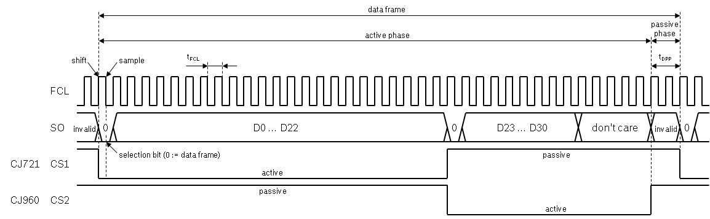
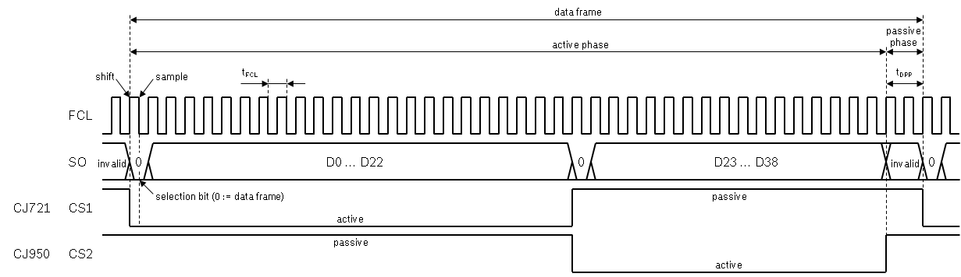
64 bit support
rba_Msc concept & design: 64 bit support
Support CJ721 and CJ960 at the same bus. Also support CJ721 and CJ950.
Data frame length
CJ721: 23 bit
CJ950: 16 bit
CJ960: 13 bit (only first 8 bits are used)
To achieve that, 64 bit support is introduced by means of extending the data frame to 64 bit and allowing 32bits for each device on a dual receiver bus.
Cross Divisional Group - Software, Methods and Tools
Internal | CDG-SMT/ESA1 | 2013-06-11 | © Robert Bosch GmbH 2013. All rights reserved, also regarding any disposal, exploitation, reproduction, editing, distribution, as well as in the event of applications for industrial property rights.

Slide 33
IFX implementation (HW)
rba_Msc concept & design: IFX implementation
The MSC module of IFX is based on the 32bit module as available in the TC17x family. In addition to all original features the following improvements where added:
Support of interrupt after stop bit
Extend the data frame from 2 x 16 bit to 2 x 32 bit -> 64 bit
Internal timeout counter
IFX Implementation of 64 bit support:
Add extension registers to SRL, SRH, DD, DSDSL and DSDSH
Extend SRL and SRH to each 32 bit
SRL₃₂ = (SRLE[15:0] << 16) | SRL[15:0]
SRH₃₂ = (SRHE[15:0] << 16) | SRH[15:0]
DD = (SRH[15:0] << 16) | SRL[15:0] (unchanged)
DDE = (SRHE[15:0] << 16) | SRLE[15:0]
DSDSL, DSDSH, both unchanged, DSDSLE and DSDSHE are the multiplexers to the corresponding shift registers SRL, SRH, SRLE and SRHE
Fully compatible with 32 bit support
Interconnection between GTM and MSC not optimal (only 32 signals doubled to 64 causing conflicts)
Starting with IFX device 5 40nm there are 48 independent signals possible
Cross Divisional Group - Software, Methods and Tools
Internal | CDG-SMT/ESA1 | 2013-06-11 | © Robert Bosch GmbH 2013. All rights reserved, also regarding any disposal, exploitation, reproduction, editing, distribution, as well as in the event of applications for industrial property rights.

Slide 34
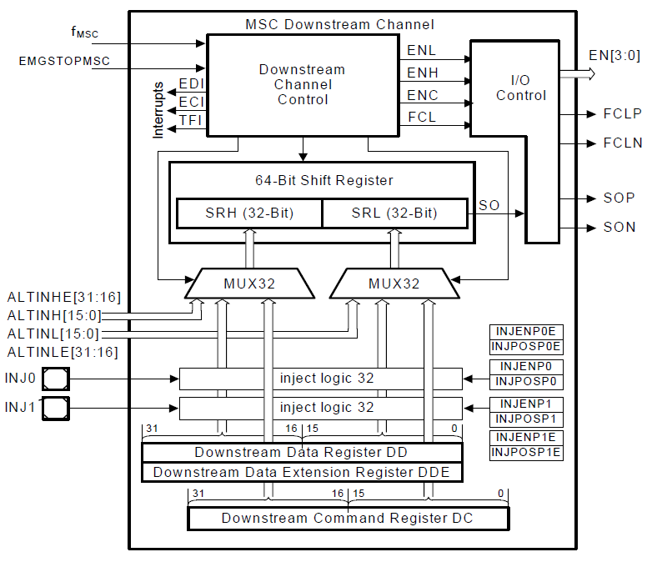
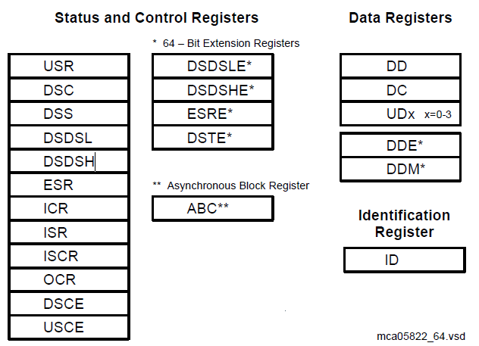
IFX implementation (HW) MSC module
rba_Msc concept & design: IFX implementation
Source: TC27x_UM_V1.2.pdf Page 2383, Figure 23-3 Downstream Channel Block Diagram
Source: TC27x_UM_V1.2.pdf Page 2428, Figure 23-37 MSC Kernel Registers
Cross Divisional Group - Software, Methods and Tools
Internal | CDG-SMT/ESA1 | 2013-06-11 | © Robert Bosch GmbH 2013. All rights reserved, also regarding any disposal, exploitation, reproduction, editing, distribution, as well as in the event of applications for industrial property rights.

Slide 35
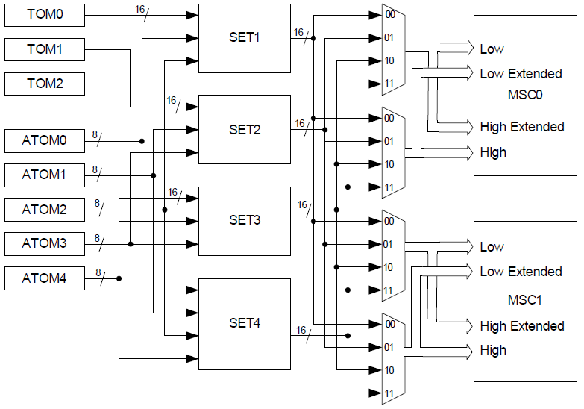
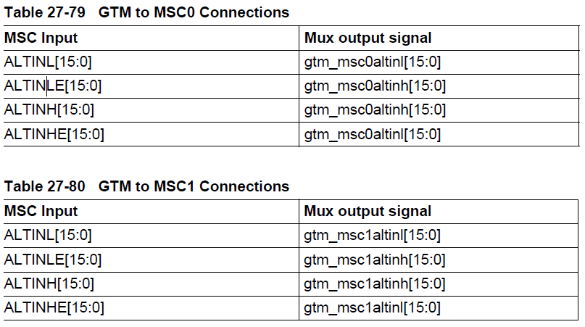
GTM – MSC connection
rba_Msc concept & design: IFX implementation
Bit numbers as forwarded to rba_Gtm
Source: TC27x_UM_V1.2.pdf Page 3849, Figure 27-84 GTM to MSC connections
31
16
15
0
ALTIN
15
ALTINH
0
15
ALTINL
0
15
SRHE
0
15
SRH
0
15
SRLE
0
15
SRL
0
Cross Divisional Group - Software, Methods and Tools
Internal | CDG-SMT/ESA1 | 2013-06-11 | © Robert Bosch GmbH 2013. All rights reserved, also regarding any disposal, exploitation, reproduction, editing, distribution, as well as in the event of applications for industrial property rights.

Slide 36
GTM – MSC connection (starting with IFX device 5 40nm) (1)
rba_Msc concept & design: IFX implementation
For better support of 2 devices on the same MSC bus, 1 with up to 32 bit and 1 with up to 16 bit data frames, ALTINLEXT is introduced
ALTINLEXT adds 16 independent GTM signals connected to SRLE
This allows conflict free connection of CJ970 and CY329 to the same MSC bus
Only SRHE and SRL still share GTM resources
ALTINLEXT[15:0] is forwarded as ALTIN[47:32] to rba_Gtm
Bit numbers as forwarded to rba_Gtm
47
32
31
ALTIN
16
15
0
15
ALTINLEXT
0
15
ALTINH
0
15
ALTINL
0
15
SRHE
0
15
SRH
0
15
SRLE
0
15
SRL
0
Cross Divisional Group - Software, Methods and Tools
Internal | CDG-SMT/ESA1 | 2013-06-11 | © Robert Bosch GmbH 2013. All rights reserved, also regarding any disposal, exploitation, reproduction, editing, distribution, as well as in the event of applications for industrial property rights.

Slide 37
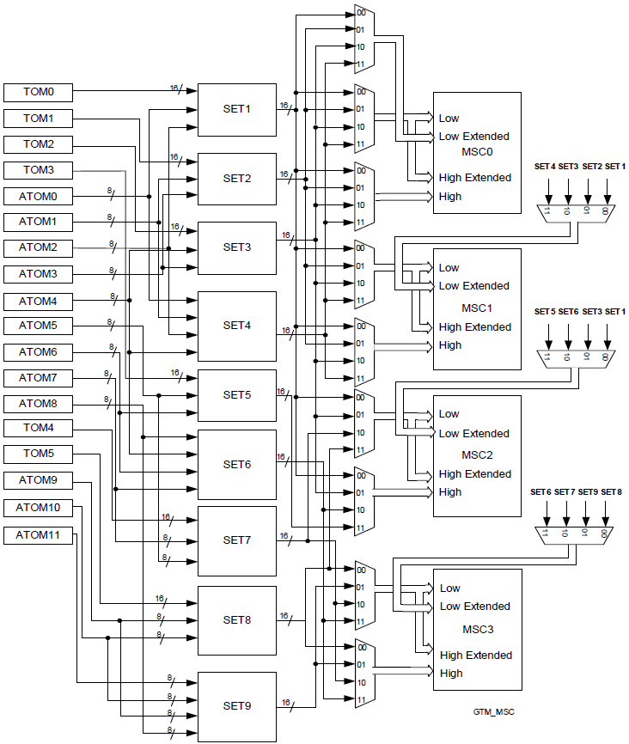
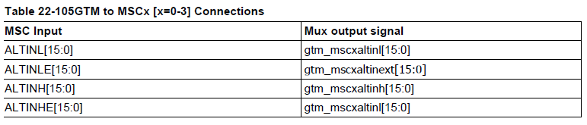
GTM – MSC connection (starting with IFX device 5 40nm) (2)
rba_Msc concept & design: IFX implementation
Source: AURIXPLUS_ts_V1.2_index.pdf Page 3121, Figure 22-142 GTM to MSC connections
Cross Divisional Group - Software, Methods and Tools
Internal | CDG-SMT/ESA1 | 2013-06-11 | © Robert Bosch GmbH 2013. All rights reserved, also regarding any disposal, exploitation, reproduction, editing, distribution, as well as in the event of applications for industrial property rights.

Slide 38
IFX implementation (SW)
rba_Msc concept & design: IFX implementation
Effort mostly in configuration script
Concentrate all data frame related measures in two functions
Reduce fragmentation of data frame knowledge
Have a singe decision matrix for the possible variations of data frames
Trying to implement 64bit support revealed that data frame configuration is done in several sub-functions of the configuration script (for JDP e.g. GetRegDsc(), GetRegDsce() and others). Especially for IFX, where there are several data frame configuration dependencies, the fragmentation made things complicated and not easy to get an overview. Therefore data frame configuration is now concentrated in a single sub-function called BuildDataFrame().
Cross Divisional Group - Software, Methods and Tools
Internal | CDG-SMT/ESA1 | 2013-06-11 | © Robert Bosch GmbH 2013. All rights reserved, also regarding any disposal, exploitation, reproduction, editing, distribution, as well as in the event of applications for industrial property rights.

Slide 39
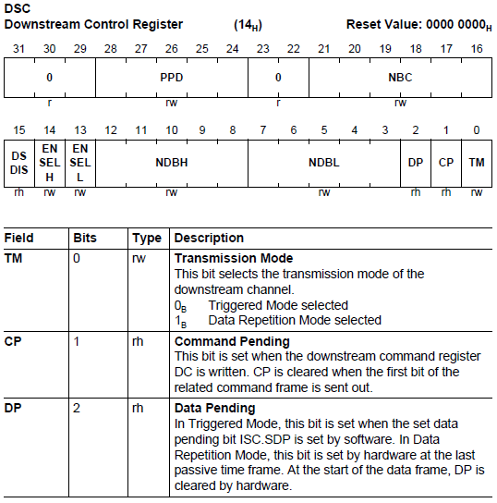
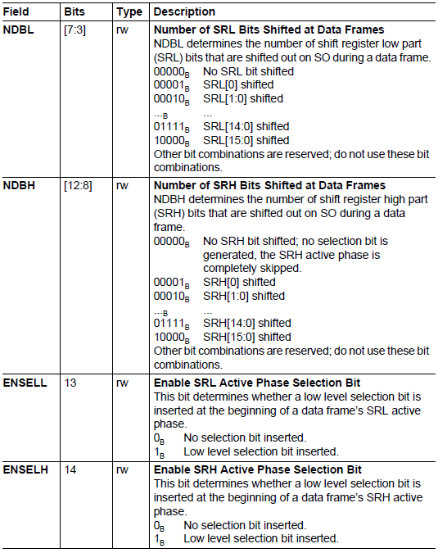
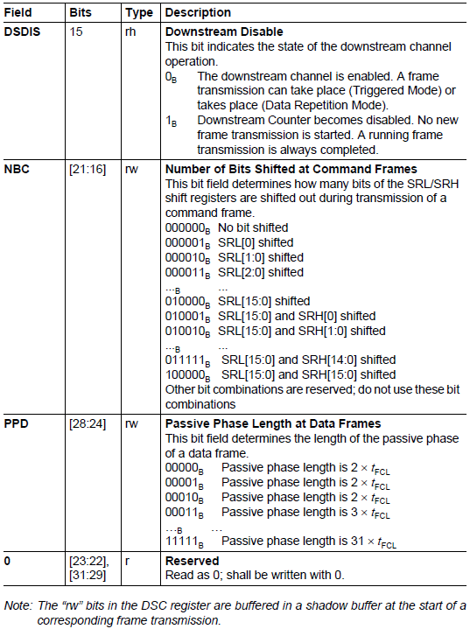
IFX: Downstream control register (DSC)
rba_Msc concept & design: IFX implementation
Cross Divisional Group - Software, Methods and Tools
Internal | CDG-SMT/ESA1 | 2013-06-11 | © Robert Bosch GmbH 2013. All rights reserved, also regarding any disposal, exploitation, reproduction, editing, distribution, as well as in the event of applications for industrial property rights.

Slide 40
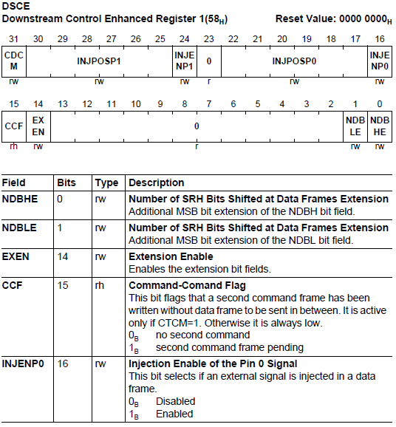
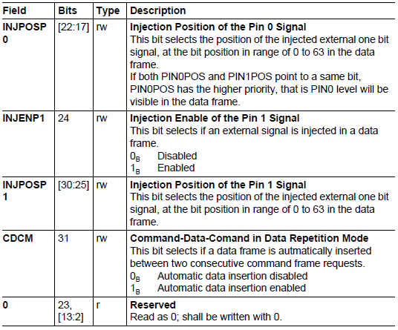
IFX: Downstream control enhanced register (DSCE)
rba_Msc concept & design: IFX implementation
Cross Divisional Group - Software, Methods and Tools
Internal | CDG-SMT/ESA1 | 2013-06-11 | © Robert Bosch GmbH 2013. All rights reserved, also regarding any disposal, exploitation, reproduction, editing, distribution, as well as in the event of applications for industrial property rights.

Slide 41
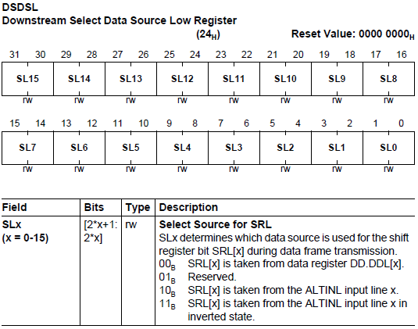
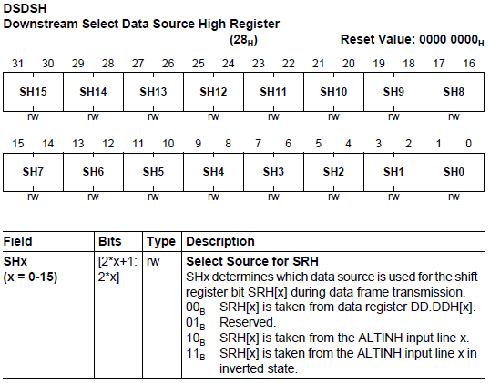
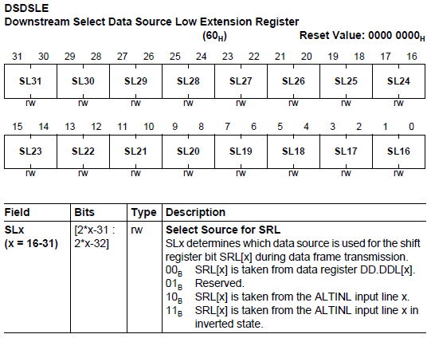
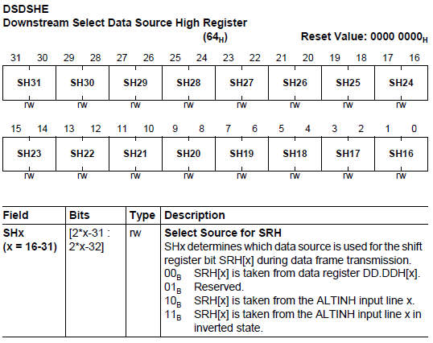
IFX: Downstream select data source (DSDSxy)
rba_Msc concept & design: IFX implementation
Cross Divisional Group - Software, Methods and Tools
Internal | CDG-SMT/ESA1 | 2013-06-11 | © Robert Bosch GmbH 2013. All rights reserved, also regarding any disposal, exploitation, reproduction, editing, distribution, as well as in the event of applications for industrial property rights.

Slide 42
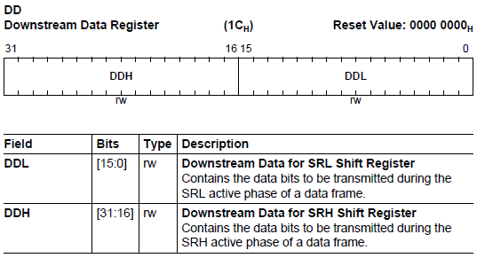
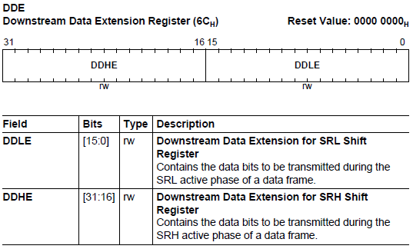
IFX: Downstream data register
rba_Msc concept & design: IFX implementation
Cross Divisional Group - Software, Methods and Tools
Internal | CDG-SMT/ESA1 | 2013-06-11 | © Robert Bosch GmbH 2013. All rights reserved, also regarding any disposal, exploitation, reproduction, editing, distribution, as well as in the event of applications for industrial property rights.

Slide 43
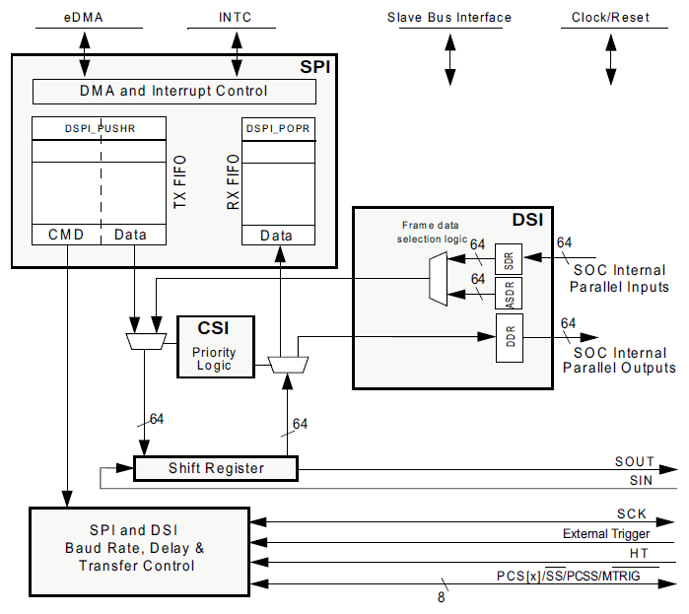
JDP: HW usage for downstream frames (DSPI)
rba_Msc concept & design: JDP implementation
command
frames
data frames
not used
Source: Matterhorn_RM_Rev2.pdf Page 1694, Figure 746: DSPI block diagram
Cross Divisional Group - Software, Methods and Tools
Internal | CDG-SMT/ESA1 | 2013-06-11 | © Robert Bosch GmbH 2013. All rights reserved, also regarding any disposal, exploitation, reproduction, editing, distribution, as well as in the event of applications for industrial property rights.

Slide 44
JDP: Data frame configuration
rba_Msc concept & design: JDP implementation
FMSZ = ((DSICR0_FMSZ5 << 5) | (DSICR0_FMSZ4 << 4) | CTAR_FMSZ)
frame size 1st device := FMSZ + 1
frame size 2nd device := DSICR1_TSBCNT – FMSZ
data frame := DSICR1_TRGPRD + 1
DSICR1_TRGPRD = DSICR1_TSBCNT + (number of selection bits) + (passive phase bits)
data frame
frame size 1st device
frame size 2nd device
shift
sample
t_{FCL}
t_{DPP}
FCL
SO
0
D0 ... D22
0
D23 ... D38
0
invalid
invalid
CJ721
CS1
selection bit (0 := data frame)
passive
active
CJ950
CS2
passive
active
Cross Divisional Group - Software, Methods and Tools
Internal | CDG-SMT/ESA1 | 2013-06-11 | © Robert Bosch GmbH 2013. All rights reserved, also regarding any disposal, exploitation, reproduction, editing, distribution, as well as in the event of applications for industrial property rights.

Slide 45
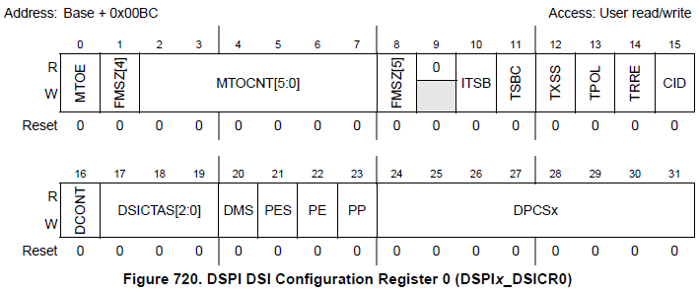
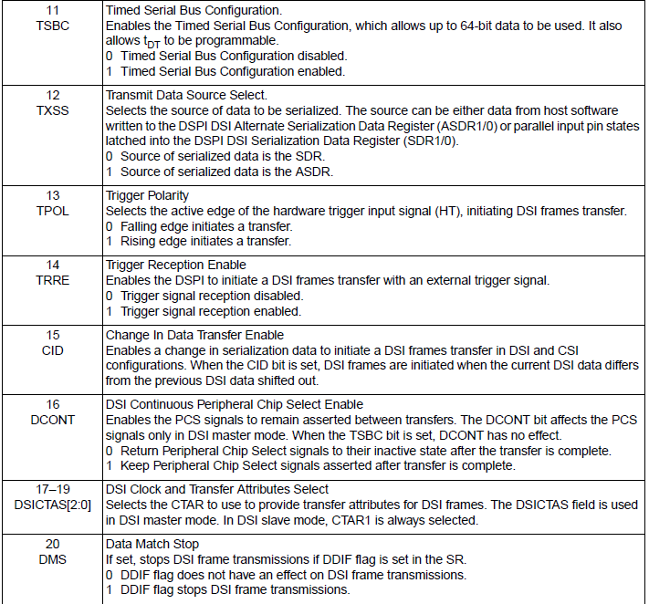
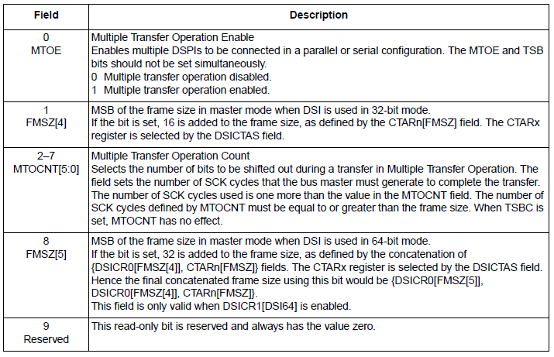
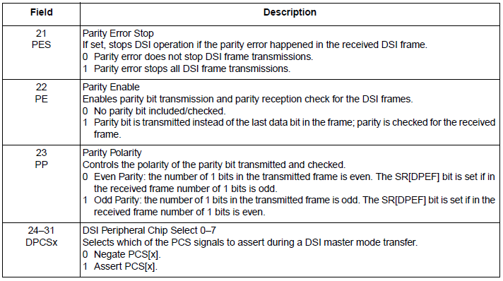
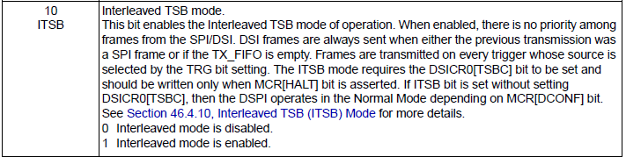
JDP: DSI configuration register 0 (DSICR0)
rba_Msc concept & design: JDP implementation
Source: D2 Reference Manual and Data Sheet Rev2.pdf Page 1411ff
Cross Divisional Group - Software, Methods and Tools
Internal | CDG-SMT/ESA1 | 2013-06-11 | © Robert Bosch GmbH 2013. All rights reserved, also regarding any disposal, exploitation, reproduction, editing, distribution, as well as in the event of applications for industrial property rights.

Slide 46
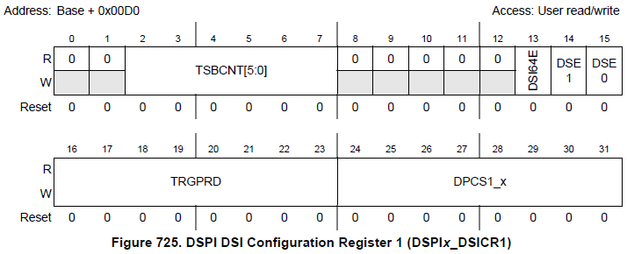
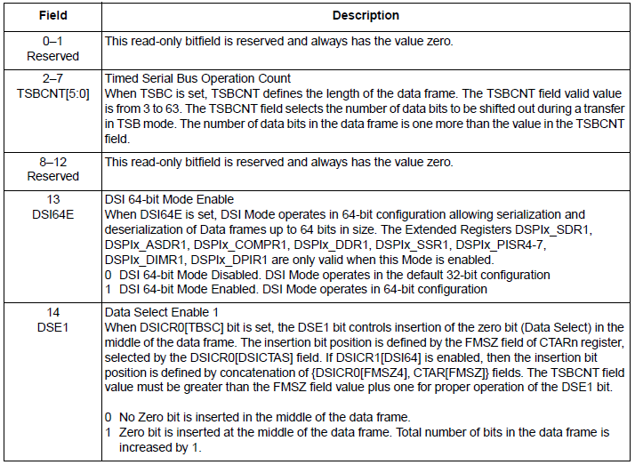
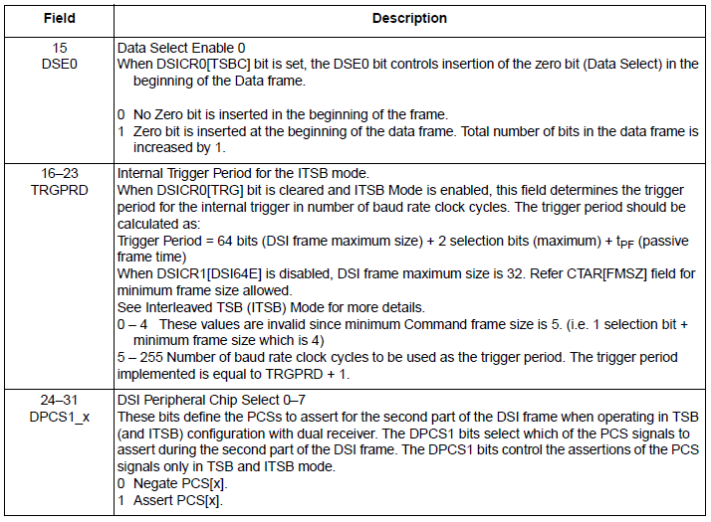
JDP: DSI configuration register 1 (DSICR1)
rba_Msc concept & design: JDP implementation
Source: D2 Reference Manual and Data Sheet Rev2.pdf Page 1418f
Cross Divisional Group - Software, Methods and Tools
Internal | CDG-SMT/ESA1 | 2013-06-11 | © Robert Bosch GmbH 2013. All rights reserved, also regarding any disposal, exploitation, reproduction, editing, distribution, as well as in the event of applications for industrial property rights.

Slide 47
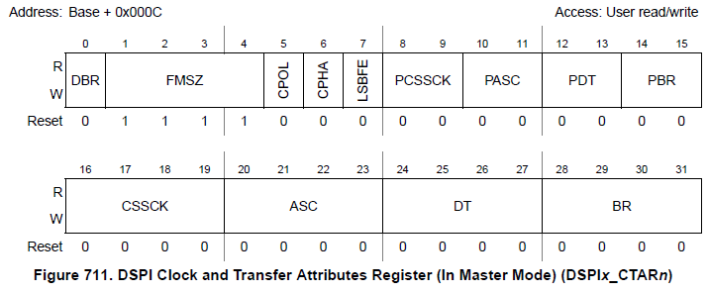
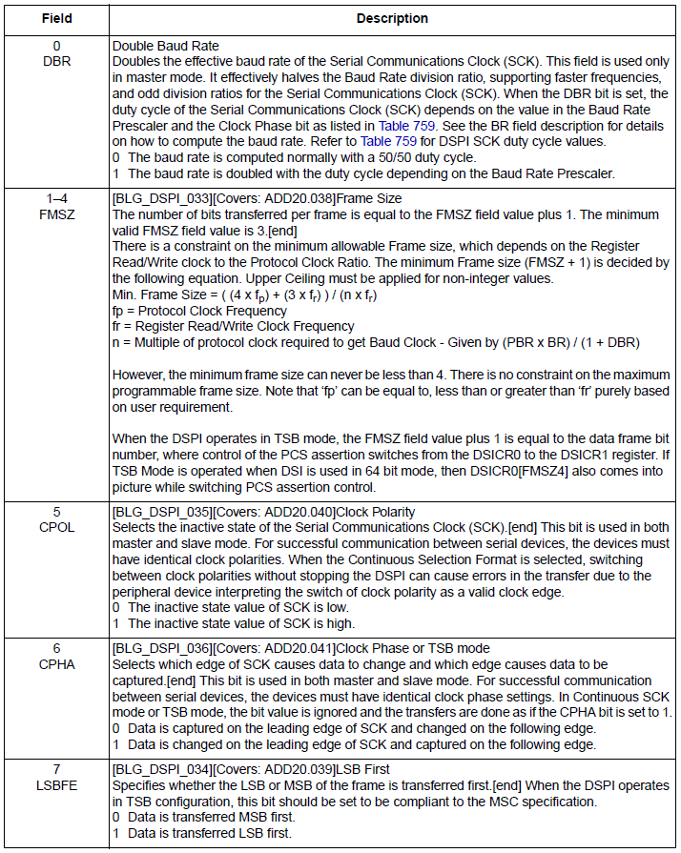
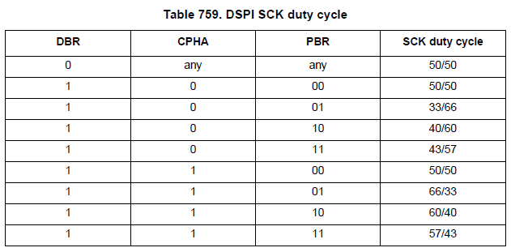
JDP: Clock and transfer attribute register (CTARx)
rba_Msc concept & design: JDP implementation
Source: D2 Reference Manual and Data Sheet Rev2.pdf Page 1391ff
Cross Divisional Group - Software, Methods and Tools
Internal | CDG-SMT/ESA1 | 2013-06-11 | © Robert Bosch GmbH 2013. All rights reserved, also regarding any disposal, exploitation, reproduction, editing, distribution, as well as in the event of applications for industrial property rights.

Slide 48
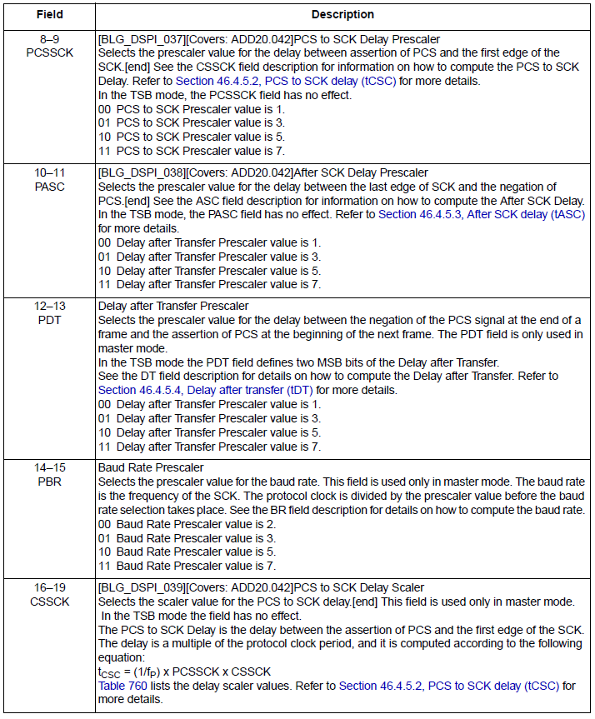
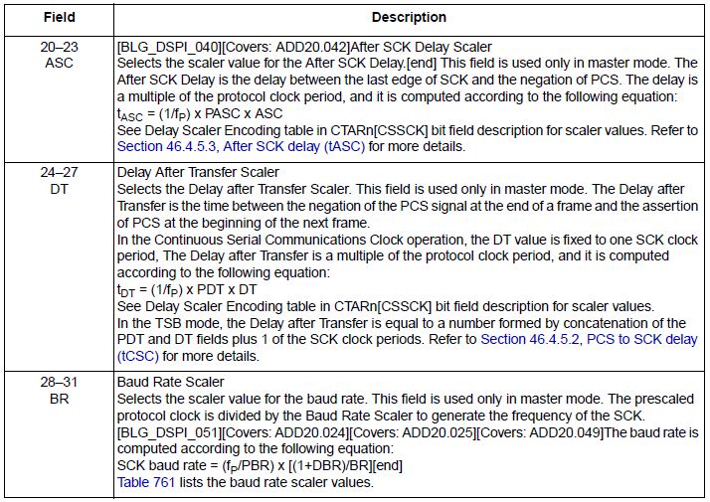
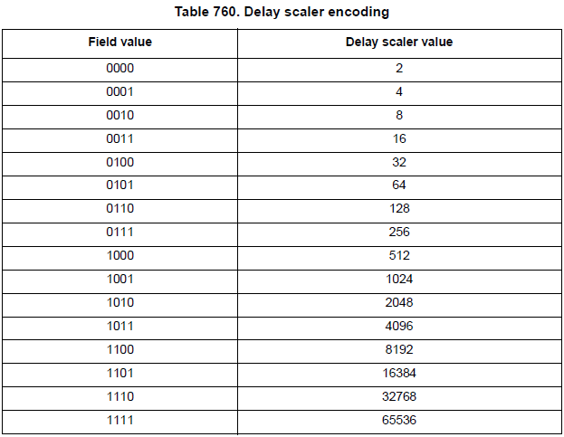
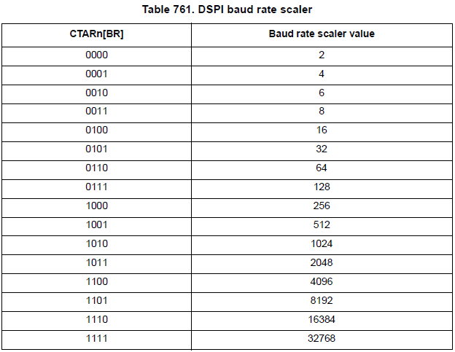
JDP: Clock and transfer attribute register (CTARx)
rba_Msc concept & design: JDP implementation
Source: D2 Reference Manual and Data Sheet Rev2.pdf Page 1391ff
Cross Divisional Group - Software, Methods and Tools
Internal | CDG-SMT/ESA1 | 2013-06-11 | © Robert Bosch GmbH 2013. All rights reserved, also regarding any disposal, exploitation, reproduction, editing, distribution, as well as in the event of applications for industrial property rights.

Slide 49
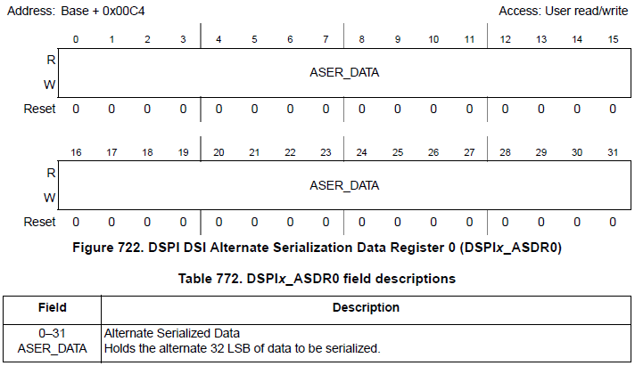
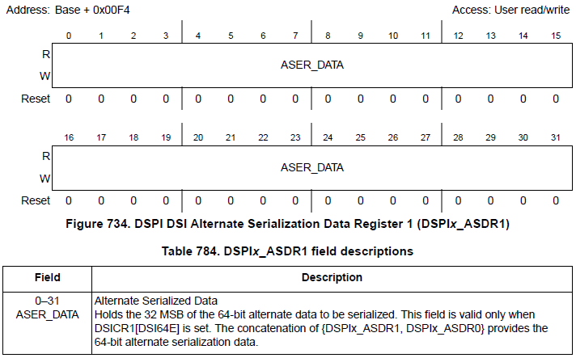
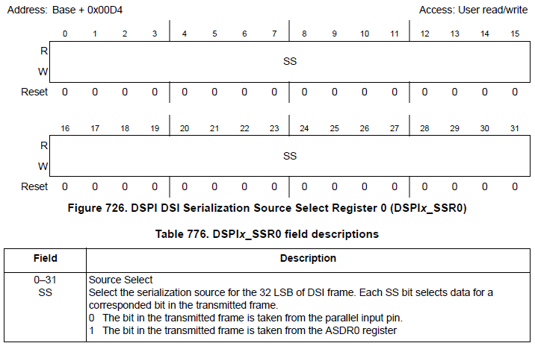
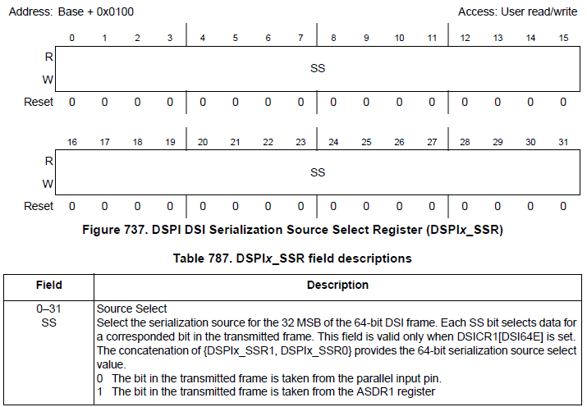
JDP: ASDRx and SSRx
rba_Msc concept & design: JDP implementation
used if 64 bit mode is enabled
Cross Divisional Group - Software, Methods and Tools
Internal | CDG-SMT/ESA1 | 2013-06-11 | © Robert Bosch GmbH 2013. All rights reserved, also regarding any disposal, exploitation, reproduction, editing, distribution, as well as in the event of applications for industrial property rights.

Slide 50
IFX: Data frame for CJ950 on SRL (32bit mode)
rba_Msc concept & design: Data frame usage (IFX)
data frame
active phase
passive
phase
shift
sample
t_{FCL}
t_{DPP}
FCL
SO
0
D0 ... D15
0
invalid
invalid
CS
selection bit (0 := data frame)
active
passive
Register representation is adjusted to the data frame timing diagram with LSB on left and MSB on right side.
0
SRL
15
0
SRLE
15
0
SRH
15
0
SRHE
15
0
ALTINL
15
0
ALTINH
15
data lines from GTM
Cross Divisional Group - Software, Methods and Tools
Internal | CDG-SMT/ESA1 | 2013-06-11 | © Robert Bosch GmbH 2013. All rights reserved, also regarding any disposal, exploitation, reproduction, editing, distribution, as well as in the event of applications for industrial property rights.

Slide 51
IFX: Data frame for CJ950 on SRH (32bit mode)
rba_Msc concept & design: Data frame usage (IFX)
data frame
active phase
passive
phase
shift
sample
t_{FCL}
t_{DPP}
FCL
SO
0
D0 ... D15
0
invalid
invalid
CS
selection bit (0 := data frame)
active
passive
Register representation is adjusted to the data frame timing diagram with LSB on left and MSB on right side.
0
SRL
15
0
SRLE
15
0
SRH
15
0
SRHE
15
0
ALTINL
15
0
ALTINH
15
data lines from GTM
Cross Divisional Group - Software, Methods and Tools
Internal | CDG-SMT/ESA1 | 2013-06-11 | © Robert Bosch GmbH 2013. All rights reserved, also regarding any disposal, exploitation, reproduction, editing, distribution, as well as in the event of applications for industrial property rights.

Slide 52
IFX: Data frame for CJ721 (32bit mode)
rba_Msc concept & design: Data frame usage (IFX)
data frame
active phase
passive
phase
shift
sample
t_{FCL}
t_{DPP}
FCL
SO
0
D0 ... D22
0
invalid
invalid
CS
selection bit (0 := data frame)
passive
active
Register representation is adjusted to the data frame timing diagram with LSB on left and MSB on right side.
0
SRL
15
0
SRLE
15
0
6
15
0
15
SRH
SRHE
*
*
0
ALTINL
15
0
6
15
ALTINH
data lines from GTM
* parallel connection of power stages located in SRL to
power stages located in SRH is not possible
Cross Divisional Group - Software, Methods and Tools
Internal | CDG-SMT/ESA1 | 2013-06-11 | © Robert Bosch GmbH 2013. All rights reserved, also regarding any disposal, exploitation, reproduction, editing, distribution, as well as in the event of applications for industrial property rights.

Slide 53
IFX: Data frame for 2 x CJ950 (32bit mode)
rba_Msc concept & design: Data frame usage (IFX)
data frame
active phase
passive
phase
shift
sample
t_{FCL}
t_{DPP}
FCL
SO
0
D0 ... D15
0
D16 ... D31
0
invalid
invalid
CJ950_1
CS1
selection bit (0 := data frame)
passive
active
CJ950_2
CS2
passive
Register representation is adjusted to the data frame timing diagram with LSB on left and MSB on right side.
active
0
SRL
15
0
SRLE
15
0
SRH
15
0
SRHE
15
0
ALTINL
15
0
ALTINH
15
data lines from GTM
Cross Divisional Group - Software, Methods and Tools
Internal | CDG-SMT/ESA1 | 2013-06-11 | © Robert Bosch GmbH 2013. All rights reserved, also regarding any disposal, exploitation, reproduction, editing, distribution, as well as in the event of applications for industrial property rights.

Slide 54
IFX: Data frame for CJ721 and CJ960
rba_Msc concept & design: Data frame usage (IFX)
data frame
active phase
passive
phase
shift
sample
t_{FCL}
t_{DPP}
FCL
SO
0
D0 ... D22
0
D23 ... D30
don’t care
0
invalid
invalid
CJ721
CS1
selection bit (0 := data frame)
passive
active
CJ960
CS2
passive
Register representation is adjusted to the data frame timing diagram with LSB on left and MSB on right side.
active
0
SRL
15
0
6
15
0
7
15
0
15
SRLE
SRH
SRHE
*
*
0
ALTINL
15
0
6
7
15
ALTINH
data lines from GTM
* parallel connection of power stages located in SRL to
power stages located in SRLE is not possible
resource conflict
(will be detected by GTM)
Cross Divisional Group - Software, Methods and Tools
Internal | CDG-SMT/ESA1 | 2013-06-11 | © Robert Bosch GmbH 2013. All rights reserved, also regarding any disposal, exploitation, reproduction, editing, distribution, as well as in the event of applications for industrial property rights.

Slide 55
IFX: Data frame for CJ721 and CJ950
rba_Msc concept & design: Data frame usage (IFX)
data frame
active phase
passive
phase
shift
sample
t_{FCL}
t_{DPP}
FCL
SO
0
D0 ... D22
0
D23 ... D38
0
invalid
invalid
CJ721
CS1
selection bit (0 := data frame)
passive
active
CJ950
CS2
passive
Register representation is adjusted to the data frame timing diagram with LSB on left and MSB on right side.
active
0
SRL
15
0
6
15
0
7
15
0
15
SRLE
SRH
SRHE
*
*
0
ALTINL
15
0
6
7
15
ALTINH
data lines from GTM
* parallel connection of power stages located in SRL to
power stages located in SRLE is not possible
resource conflict
(will be detected by GTM)
Cross Divisional Group - Software, Methods and Tools
Internal | CDG-SMT/ESA1 | 2013-06-11 | © Robert Bosch GmbH 2013. All rights reserved, also regarding any disposal, exploitation, reproduction, editing, distribution, as well as in the event of applications for industrial property rights.

Slide 56
JDP: Data frame for CJ721 and CJ950
rba_Msc concept & design: Data frame usage (JDP)
data frame
active phase
passive
phase
shift
sample
t_{FCL}
t_{DPP}
FCL
SO
0
D0 ... D22
0
D23 ... D38
0
invalid
invalid
CJ721
CS1
selection bit (0 := data frame)
passive
active
CJ950
CS2
passive
Register representation is adjusted to the data frame timing diagram with LSB on left and MSB on right side.
active
0
SDR0
22
23
31
0
6
SDR1
31
LSB 0 bit numbering used here (in contrary to the JDP manual which uses MSB 0 bit numbering)
parallel connection of power stages located in SDR0 to power stages located in SDR1 is not possible
Cross Divisional Group - Software, Methods and Tools
Internal | CDG-SMT/ESA1 | 2013-06-11 | © Robert Bosch GmbH 2013. All rights reserved, also regarding any disposal, exploitation, reproduction, editing, distribution, as well as in the event of applications for industrial property rights.

Slide 57
JDP: Data frame for CJ950 and CJ721
rba_Msc concept & design: Data frame usage (JDP)
data frame
active phase
passive
phase
shift
sample
t_{FCL}
t_{DPP}
FCL
SO
0
D0 ... D15
0
D16 ... D38
0
invalid
invalid
CJ950
CS1
selection bit (0 := data frame)
passive
active
CJ721
CS2
passive
Register representation is adjusted to the data frame timing diagram with LSB on left and MSB on right side.
active
0
15
16
31
0
6
31
SDR0
SDR1
LSB 0 bit numbering used here (in contrary to the JDP manual which uses MSB 0 bit numbering)
parallel connection of power stages located in SDR0 to power stages located in SDR1 is not possible
Cross Divisional Group - Software, Methods and Tools
Internal | CDG-SMT/ESA1 | 2013-06-11 | © Robert Bosch GmbH 2013. All rights reserved, also regarding any disposal, exploitation, reproduction, editing, distribution, as well as in the event of applications for industrial property rights.

Slide 58
JDP: Data frame for CJ960 and CJ721
rba_Msc concept & design: Data frame usage (JDP)
data frame
active phase
passive
phase
shift
sample
t_{FCL}
t_{DPP}
FCL
SO
0
D0 ... D7
don’t care
0
D13 ... D35
0
invalid
invalid
CJ950
CS1
selection bit (0 := data frame)
passive
active
CJ721
CS2
passive
Register representation is adjusted to the data frame timing diagram with LSB on left and MSB on right side.
active
0
7
8
12
13
SDR0
31
0
3
SDR1
31
LSB 0 bit numbering used here (in contrary to the JDP manual which uses MSB 0 bit numbering)
parallel connection of power stages located in SDR0 to power stages located in SDR1 is not possible
bits not used because of
data frame size of CJ960
Cross Divisional Group - Software, Methods and Tools
Internal | CDG-SMT/ESA1 | 2013-06-11 | © Robert Bosch GmbH 2013. All rights reserved, also regarding any disposal, exploitation, reproduction, editing, distribution, as well as in the event of applications for industrial property rights.

Slide 59
rba_Msc concept & design: Backlog
Backlog
Cross Divisional Group - Software, Methods and Tools
Internal | CDG-SMT/ESA1 | 2013-06-11 | © Robert Bosch GmbH 2013. All rights reserved, also regarding any disposal, exploitation, reproduction, editing, distribution, as well as in the event of applications for industrial property rights.

Slide 60
Data frame CJ950 (1 x 16 bit)
rba_Msc concept & design: Backlog
data frame
active phase
passive
phase
shift
sample
t_{FCL}
t_{DPP}
FCL
SO
0
D0 ... D15
0
invalid
invalid
CS
selection bit (0 := data frame)
active
passive
Cross Divisional Group - Software, Methods and Tools
Internal | CDG-SMT/ESA1 | 2013-06-11 | © Robert Bosch GmbH 2013. All rights reserved, also regarding any disposal, exploitation, reproduction, editing, distribution, as well as in the event of applications for industrial property rights.

Slide 61
Data frame 2 x CJ950 (2 x 16 bit)
rba_Msc concept & design: Backlog
data frame
active phase
passive
phase
shift
sample
t_{FCL}
t_{DPP}
FCL
SO
0
D0 ... D15
0
D16 ... D31
0
invalid
invalid
CS1
selection bit (0 := data frame)
passive
active
CS2
passive
active
Cross Divisional Group - Software, Methods and Tools
Internal | CDG-SMT/ESA1 | 2013-06-11 | © Robert Bosch GmbH 2013. All rights reserved, also regarding any disposal, exploitation, reproduction, editing, distribution, as well as in the event of applications for industrial property rights.

Slide 62
Data frame CJ721 (23 bit)
rba_Msc concept & design: Backlog
data frame
active phase
passive
phase
shift
sample
t_{FCL}
t_{DPP}
FCL
SO
0
D0 ... D22
0
invalid
invalid
CS1
selection bit (0 := data frame)
passive
active
Cross Divisional Group - Software, Methods and Tools
Internal | CDG-SMT/ESA1 | 2013-06-11 | © Robert Bosch GmbH 2013. All rights reserved, also regarding any disposal, exploitation, reproduction, editing, distribution, as well as in the event of applications for industrial property rights.

Slide 63
Data frame CJ721 (23 bit) and CJ960 (13 bit)
rba_Msc concept & design: Backlog
data frame
active phase
passive
phase
shift
sample
t_{FCL}
t_{DPP}
FCL
SO
0
D0 ... D22
0
D23 ... D30
don’t care
0
invalid
invalid
CJ721
CS1
selection bit (0 := data frame)
passive
active
CJ960
CS2
passive
active
Cross Divisional Group - Software, Methods and Tools
Internal | CDG-SMT/ESA1 | 2013-06-11 | © Robert Bosch GmbH 2013. All rights reserved, also regarding any disposal, exploitation, reproduction, editing, distribution, as well as in the event of applications for industrial property rights.

Slide 64
Data frame CJ960 (13 bit) and CJ721 (23 bit)
rba_Msc concept & design: Backlog
data frame
active phase
passive
phase
shift
sample
t_{FCL}
t_{DPP}
FCL
SO
0
D0 ... D7
don’t care
0
D13 ... D35
0
invalid
invalid
CJ950
CS1
selection bit (0 := data frame)
passive
active
CJ721
CS2
passive
active
Cross Divisional Group - Software, Methods and Tools
Internal | CDG-SMT/ESA1 | 2013-06-11 | © Robert Bosch GmbH 2013. All rights reserved, also regarding any disposal, exploitation, reproduction, editing, distribution, as well as in the event of applications for industrial property rights.

Slide 65
Data frame CJ721 (23 bit) and CJ950 (16 bit)
rba_Msc concept & design: Backlog
data frame
active phase
passive
phase
shift
sample
t_{FCL}
t_{DPP}
FCL
SO
0
D0 ... D22
0
D23 ... D38
0
invalid
invalid
CJ721
CS1
selection bit (0 := data frame)
passive
active
CJ950
CS2
passive
active
Cross Divisional Group - Software, Methods and Tools
Internal | CDG-SMT/ESA1 | 2013-06-11 | © Robert Bosch GmbH 2013. All rights reserved, also regarding any disposal, exploitation, reproduction, editing, distribution, as well as in the event of applications for industrial property rights.

